Slide 1
Status update on ANIMA WG SACM WG IETF102
Toerless Eckert, Futurewei USA (tte@cs.fau.de)
07/24/2021
Slides at github.com/toerless/presenations/slides-ietf111-sacm-eckert-anima…

Slide 2
Background
The Autonomic Networking Integrated Model and Approach (ANIMA) working group develops and maintains specifications and documentation for interoperable protocols and procedures for secure automated network management and control of professionally-managed (*) networks.
ANIMA as a good fit of SACM goals and a good platform for further SACM work ?!
After ANIMA was formed, we did consult with SACM for alignment guidance
And then we went away into producing our charter round 1 RFC and only recently charter round 2.
Now we felt it was a good time to cirble back to SACM updating on what we didand encourage further collaboration / input from SACM community
(*) ANIMA does not want to step on HOMENET

Slide 3
From NMRG to ANIMA
+------------------------------------------------------------+
| Intent based Network Management |
+------------------------------------------------------------+
| +------------+ |
| | Feedback | |
| | Loops | |
| +------------+ |
| ^ |
| Autonomic User Agent |
| V |
| +-----------+ +------------+ +------------+ |
| | Self- | | Autonomic | | Network | |
| | knowledge |<------>| Service |<------>| Knowledge | |
| | | | Agents | | (Discovery)| |
| +-----------+ +------------+ +------------+ |
| ^ ^ |
| | | |
| V V |
|------------------------------------------------------------|
| Autonomic Network Infrastructure (ANI) |
|------------------------------------------------------------|
| Standard Operating System Functions |
+------------------------------------------------------------+
Figure 1: Reference Model for an Autonomic Node
from RFC7575 slightly enhanced
NMRG Autonomic Networks:
Self-X networks. X = configuring, healing, managing, optimizing, protecting, …. RFC7575/RFC7576
Network wide Intent based management
ASA – Autonomic Service Agents.
Distributed software modules embodying a decentralized or distributed function/service on network devics.
ANI - Autonomic Network Infrastructure
Common infra for ASA and secure automation of legacy networks
BRKI: Secure, zero-touch bootstrap/onboarding
ACP: Secure zero-touch network wide connectivity
GRASP: Secure zero-touch extensible signaling

Slide 4

ANIMA Charter round 1 (ANI) published
Autonomic Neworking Infrastructure (ANI)
May 2021 RFC-Editor Cluster 325, 420 pages
RFC8366: Validation use case 1: Stable Connectivity (23 pages)
RFC8368: BRSKI voucher (24 pages)
RFC8990: GRASP – Generic Autonomic Signaling Protocol (55 pages)
RFC8991: GRASP API (29 pages)
RFC8992: Validation use case 2: Prefix Management (19 pages)
RFC8993: Autonomic Networking Reference Model (26 pages)
RFC8994: ACP – Autonomic Control Plane (128 pages)
RFC8995: BRSKI – Bootstrap Remote Key Infrastructures (116 pages)
Fig.1: Use-case example,
Autonomous opening of champagne bottle

Slide 5

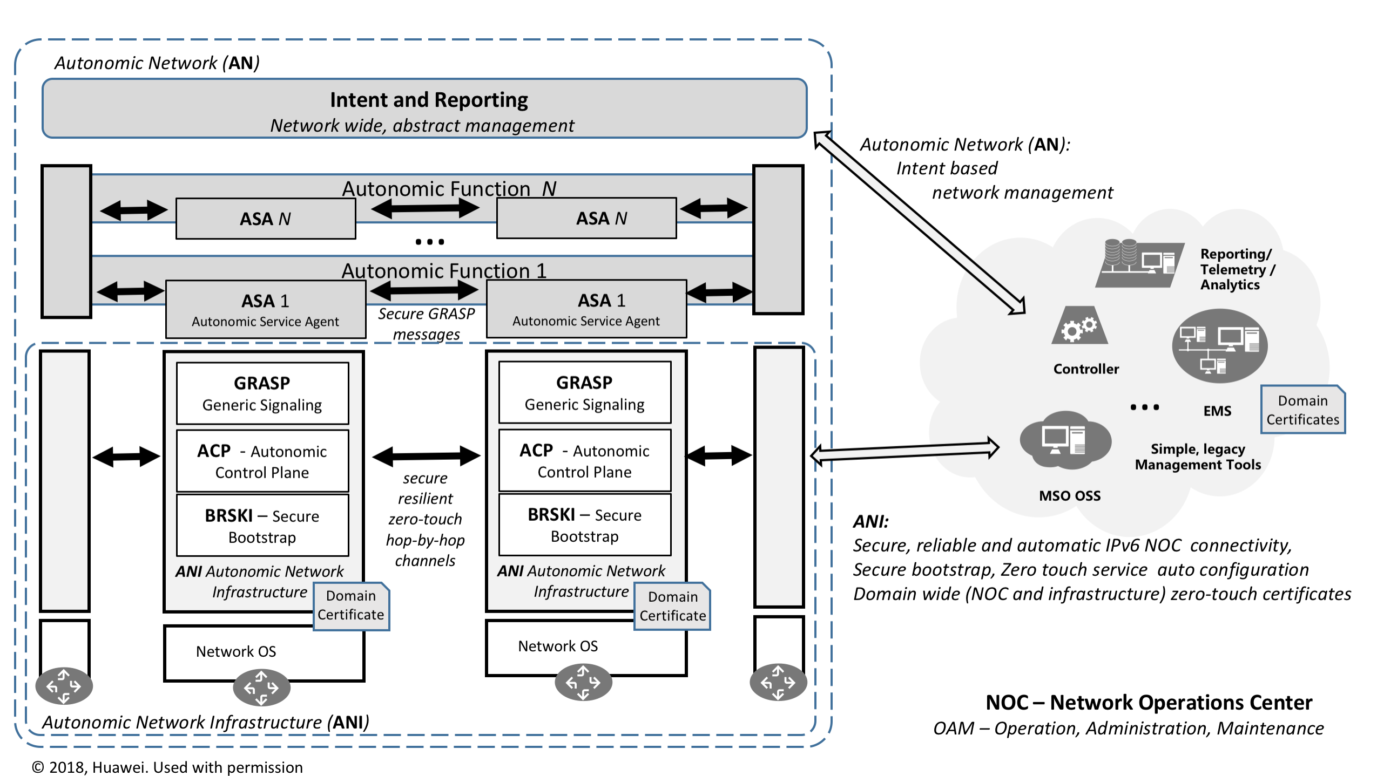
For Self Study: Autonomic Network according to ANIMA RFC8993

Slide 6

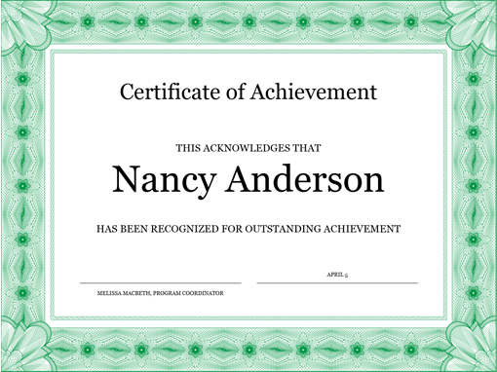






ANI operater experience
“NOC”
Controller
Orchestrator
…
Mgmt
Laptop
Domain
Certificate
Day 1: Wide area network physically plugged together, connected to NOC, no CLI configured on any router, controller/orchestrator did nothing.
ANI/BRSKI gave all devices automatically X.509 ANI domain certificates
ANI/ACP automatically establishes on every link a secure ACP tunnel and on ever node a VRF with network wide IPv6 connectivity ONLY for OAM by ASA or legacy NOC equipment, not for user traffic (in-band virtual network)
ANI/GRASP running across ANI/ACP provides service discovery for existing decentralized services e.g.: in NOC and common new signaling for ASA
No user packets will flow (nothing was configured). Unauthorized equipment can not connect, Attackers can not even eavesdrop ACP traffic on any link.
Manual / SDN / ASA provisioning/startup of config/services can commence
Day 1…N: Secure, Stable connectivity: Operator/Controller can configure any ANI device without out-of-band network. Misconfiguration of addressing, routing, security or other features can not disconnect NOC from ANI nodes, because ANI/ACP is not configurable (autonomous)
ACP will automatically adjust to new/failed links/nodes (ACP RPL routing protocol).
BRSKI/EST will automatically renew domain certificates
New ANI nodes can be added any time, impaired nodes can be revoked from ACP via their certificates.
Domain
Certificate
Domain
Certificate
Domain
Certificate
Domain
Certificate
Domain
Certificate
Domain
Certificate
Domain
Certificate
Domain
Certificate
Domain
Certificate
Domain
Certificate
Autonomous or legacy network with ANI
Domain
Certificate
BRSKI Domain
Certificate
ACP secure virtual connections
With GRASP signaling

Slide 7

How to bootstrap ANI
Manufacturer 1
MASA
Manufacturer N
MASA
Only required config to get ANI
running (example)
…
ani registrar
domain-name ani.example.com
Ethernet 0
acp-connect
Register my cert with vendor MASAs
Internet
“NOC”
Mgmt
Laptop
Seed Router
ANI BRSKI/PKI Registrar
and CA (example)
Domain
Certificate
Ethernet 0

Slide 8








Bootstrap to ANI domain membership Eensemble cast, not the script
Candidate ANI
Device:
Pledge
Domain
Admission
Controller
Domain Registrar
Drives/coordinates process
Pledge
The new, to-become domain member device
Proxy
Distributed Agent to give registrar connectivity to adjacent pledge
Manufacturer (MASA)
Authorizes Registrar towards Pledge so Pledge will permit to be enrolled into domain
Voucher
New digital artefact to indicate to Pledge that Registrar is authorized to control Pledge
Admission Control
ACP Address allocation
Certificate (signing)
Rely on certificate authority (CA) Potentially a hierarchy.
Optional
Get permission
to admit
pledge
Voucher
Certificate
fe8…@lake
Address allocation database
Chick6: fd89b714f3db0000200000064000006
BRSKI/ACP
Proxy
DO NOT
ERASE
Voucher
Allocate ACP Address
Make CA
Sign pledge
certificate
Certificate
fe8…@lake
Certificate
fe8…@lake
CA Certificate Authority
Get Plede
identity
Enroll
Certificate
With ACP info
(address)
Voucher
Domain
Registrar
Optional
For
secure/ANI
Pledges:
Get voucher
MASA
(Manufacturer Authority)

Slide 9

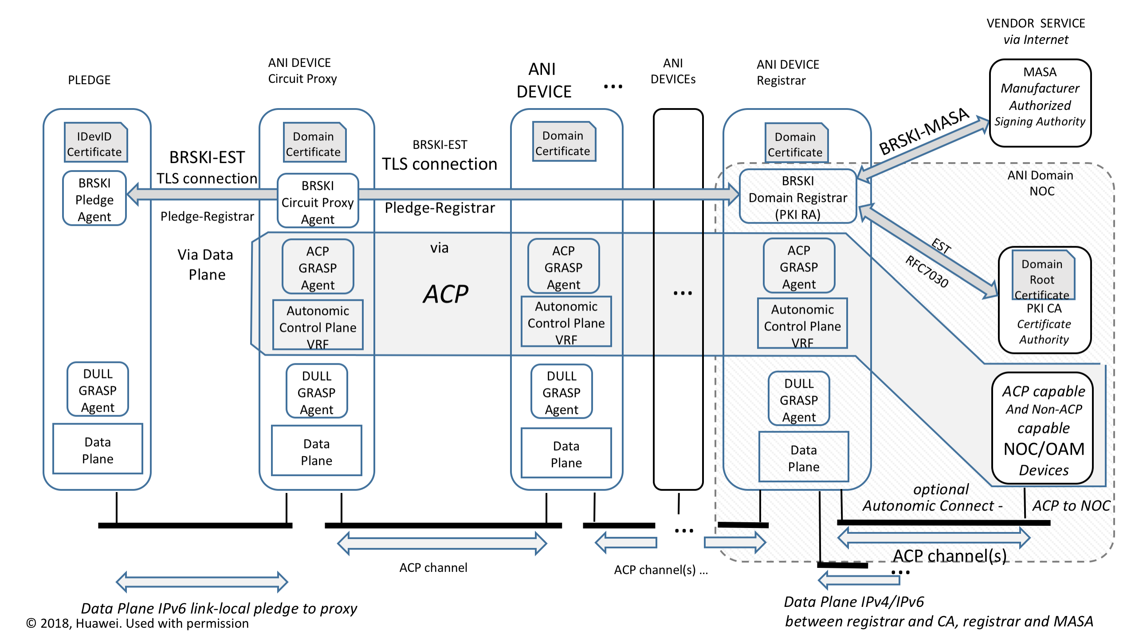
For self-study: How does it really work – ANI (1)

Slide 10
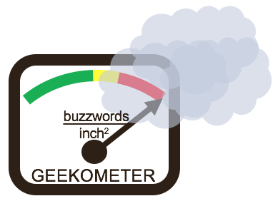
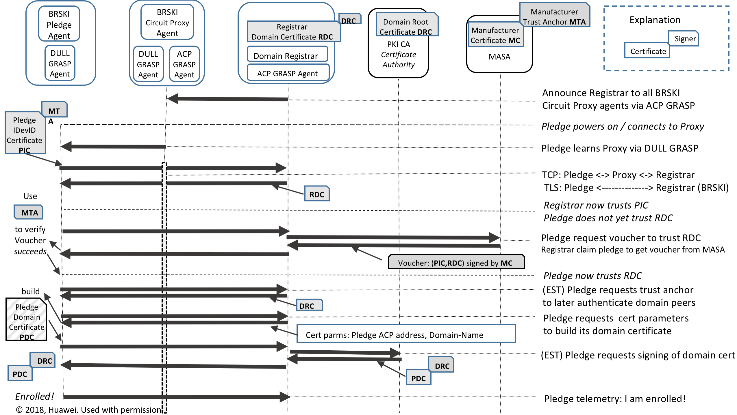
For self-study: How does it really work - BRSKI (2)

Slide 11
Where are we now
Since Q2’ 2020 on 2nd Charter
Added ASA work to charter
Added ANI enhancement
Pushed out Intent back to NMRG
NMRG nicely working on the research steps
But key ANIMA contributors busy with chater 1 until May.
ANI: Bootstrap sees quite wide proliferation/adoption across IETF and industry (next slide)
Hackathon at IETF111, Also iot-onboarding / MUD adjacencies
Relatively little new code to write (on top of exising PKI, tool chains), but quite security critical
(Toerless) way too many different protocol preferences in different markets = many varitions needed.
Try to keep a common framework/common security behavior
Key work items: “constrained” devices BRSKI / voucher, cloud-connected registrar
ANI: ACP seeing little movement yet
Logical ? Bootstrap must first work
Pre-standard industry implementations
(Toerless) Complex to implement well in legacy router infrastructures (much easier with newer/containerized/virtualized infrastructures, or BMC
Various prototype implementations exist
More implementations welcome

Slide 12
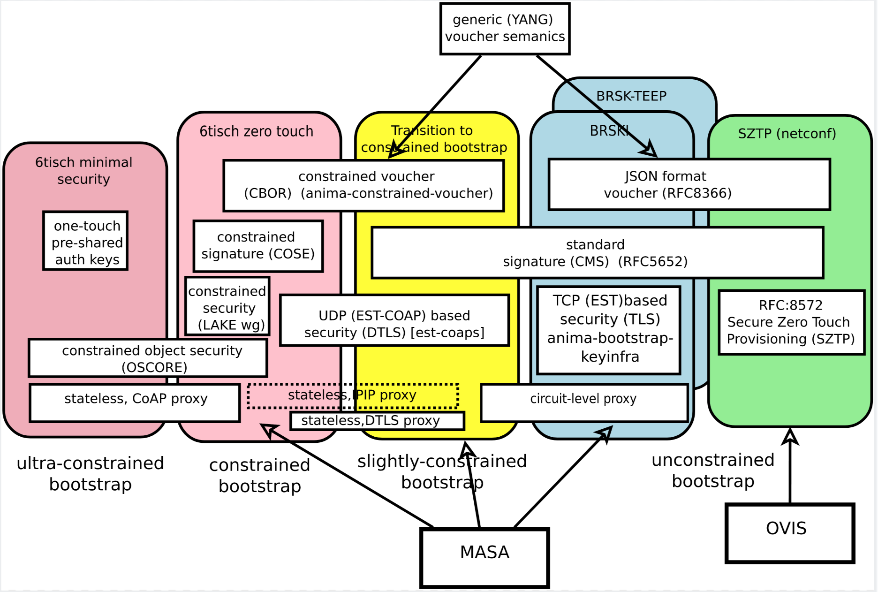
Bootstrap landscape / roadmap https://github.com/anima-wg/enrollment-roadmap (somewha stale)

Slide 13
What is next ? ASA ?!
Ongoing work in NMRG, then maybe ANIMA ?
+------------------------------------------------------------+
| Intent based Network Management |
+------------------------------------------------------------+
| +------------+ |
| | Feedback | |
| | Loops | |
| +------------+ |
| ^ |
| Autonomic User Agent |
| V |
| +-----------+ +------------+ +------------+ |
| | Self- | | Autonomic | | Network | |
| | knowledge |<------>| Service |<------>| Knowledge | |
| | | | Agents | | (Discovery)| |
| +-----------+ +------------+ +------------+ |
| ^ ^ |
| | | |
| V V |
|------------------------------------------------------------|
| Autonomic Network Infrastructure (ANI) |
|------------------------------------------------------------|
| Standard Operating System Functions |
+------------------------------------------------------------+
Figure 1: Reference Model for an Autonomic Node
from RFC7575 slightly enhanced
!?
What distributed/decentralized services are of interest ?
especially also for security
We have seen many comprehensive,
ambitious architectur proposals in ANIMA over the years
But ANIMA is in OPS, so we are primarily interested in stuff that can be operationalized (easily)
ANI with GRASP makes this easy and agile – including experimentation / prototyping
ANI and xtensions: Done/ongoing in ANIMA
and especially bootstrap also in other groups

Slide 14
Pragmatic considerations (1) (sorry, no eye candy)
Application protocols with End-to-end encrypion (TLS, QUIC)
Do often not use strong, automatically renewed and flexible PKI certificates but just TLS with username/password and Web PKI with thir problematic Trust Anchor management.
Certificate management often seen as difficult by operators
Just use ANI certificates ?!
Simply relying on ANI certificate could help to automate/use strong crypto for end-to-end applications
If existing ANI services are not sufficient, additional (higher layer) automation can be implemented as ASA
E.g.: additional role/authorization functionality for certificates via ANI/ASA so certificates become more functional

Slide 15
Pragmatic considerations (2) (sorry, no eye candy)
Existing infrastructure services protocols are often not deployed with “security”
Operationaly hard to do key management and bootstrap for the services.
NTP, DNS, SMTP, MacSec, routing protocols, “tftp”, IPFIX and several others
When complely insecure protocols are run across ACP, their traffic is protected by ACP
Hop-by-hop authentication/encryption
But many need their own, non-certificate credentials
And several should not run across ACP (OAM plane)
ACP/GRASP ASA to the rescue
ASA does not need to worry about how to discover candidate protocol peers (link-local or ,network wide) whether to trust them, or how to come up with new messages – All done by ACP/GRASP
Simple to write distributed scripts (e.g.: TCL or pyhon) to automate generation and provisioning of such keying material
Automating e.g.: securing of routing protocols wih dynamic keys could be maybe a < 100 lines of code script using GRASP API (TBD)

Slide 16
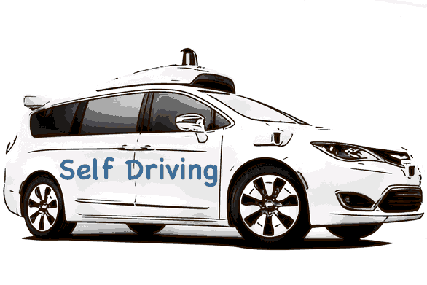
If networks where cars
SDN-Controller
SDN-Orchestrator
SDN-Developer
Data Analyst
Network operator
Security Expert
In-network intelligence
ANIMA
networks
“self driving networks”

Slide 17
The End
Please engage with us (proposal, questions, suggestion) if you think this is useful for you ! – anima@ietf.org

